Slide 1


Remote Shell Using RPC For Multiple User

Slide 2
Group 3
Nguyen Huy Hung
Hoang Huu Huy
Nguyen Hoang Nam
Nguyen Minh Duc
Nguyen Quoc Hung

Slide 3
WHAT IS RPC
A SOFTWARE COMMUNICATION PROTOCOL
ALLOW A PROGRAM LOCATED REQUEST A SERVE ON NETWORK.
USES CLIENT-SERVER MODEL
KNOWN AS FUNCTION CALL OR SUBROUTINE CALL

Slide 4
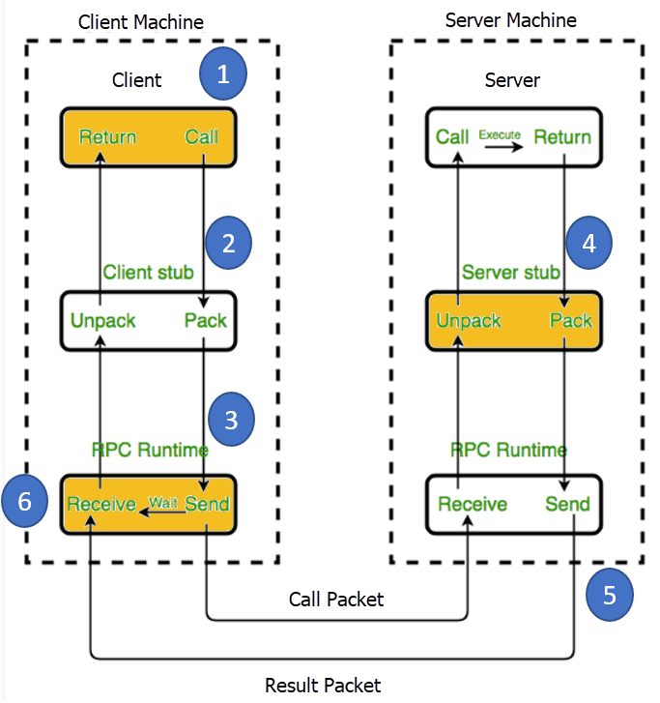
HOW RPC WORKS

Slide 5

WHAT IS REMOTE SHELL
The remote shell is a command line computer program that can execute shell commands as another user, and on another computer across a computer network.(wiki)

Slide 6
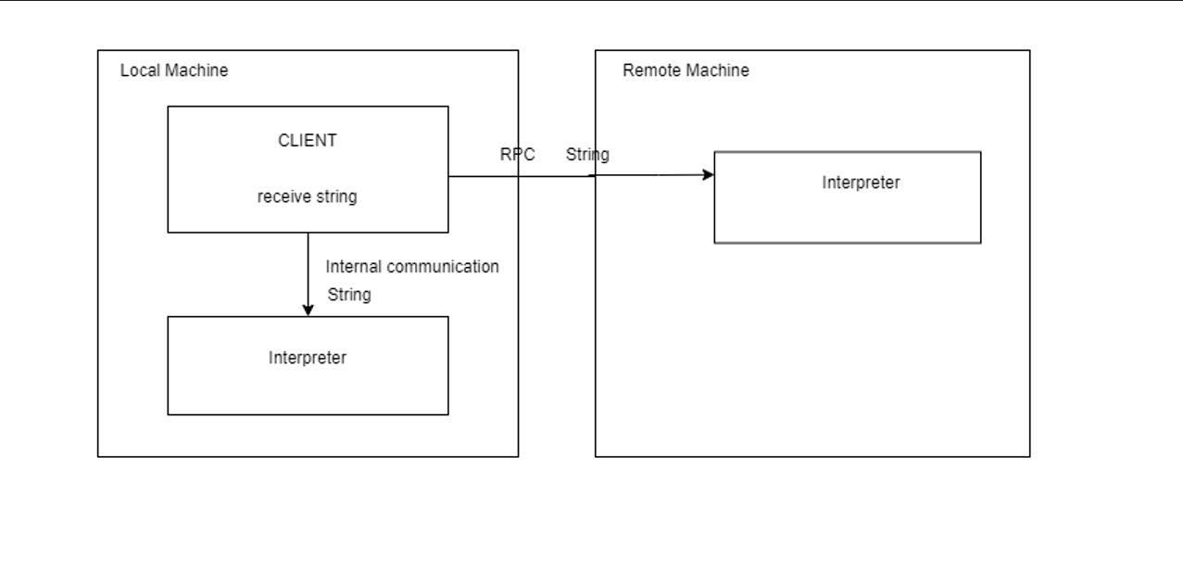
REMOTE SHELL USING RPC
IDEAS

Slide 7
REMOTE SHELL USING RPC
SunRPC
METHODS
Implementation of RPC
➔ SunRPC
How to multiple user?
➔ Define by host in client side
UDP
IP
ETH

Slide 8
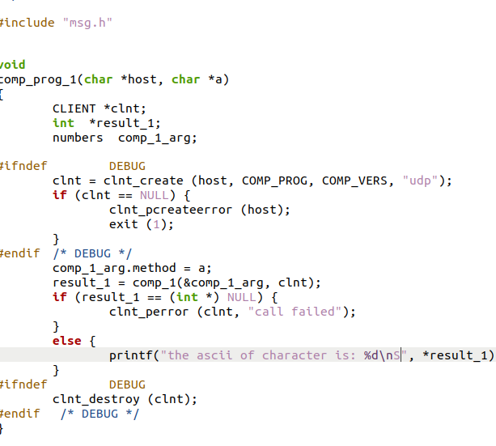
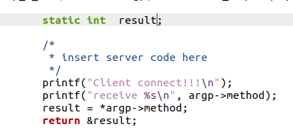
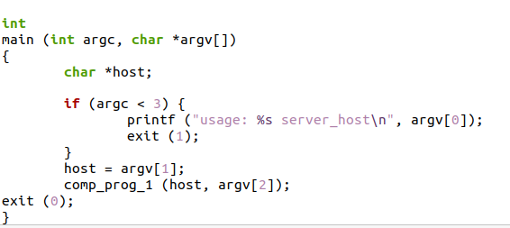
REMOTE SHELL USING RPC
SOME CODES
Client
Server

Slide 9


REMOTE SHELL USING RPC
RESULT
Server Side
Client side

Slide 10
CONCLUSION
➔RPC is a good way for connect between client and server.
➔For multiple users the way access is by check the host ip address
➔We can define not block I/O or not.

Slide 11
THANK FOR LISTENING

